Slide 1
τ -Inflated Beta Regression Model for Estimating τ -Restricted Means and Event-Free Probabilities for Censored Time-to-Event Data.
Joint work with Yizhuo Wang
Source Material:
https://pmc.ncbi.nlm.nih.gov/articles/PMC11604032
https://github.com/yezow/--Inflated-Beta-Regression-Model-for-Estimating--RMST (Manuscript Github Site)
Ann Arbor ASA Meeting Github Site: https://github.com/yezow/tau-IBR_ASA

Slide 2
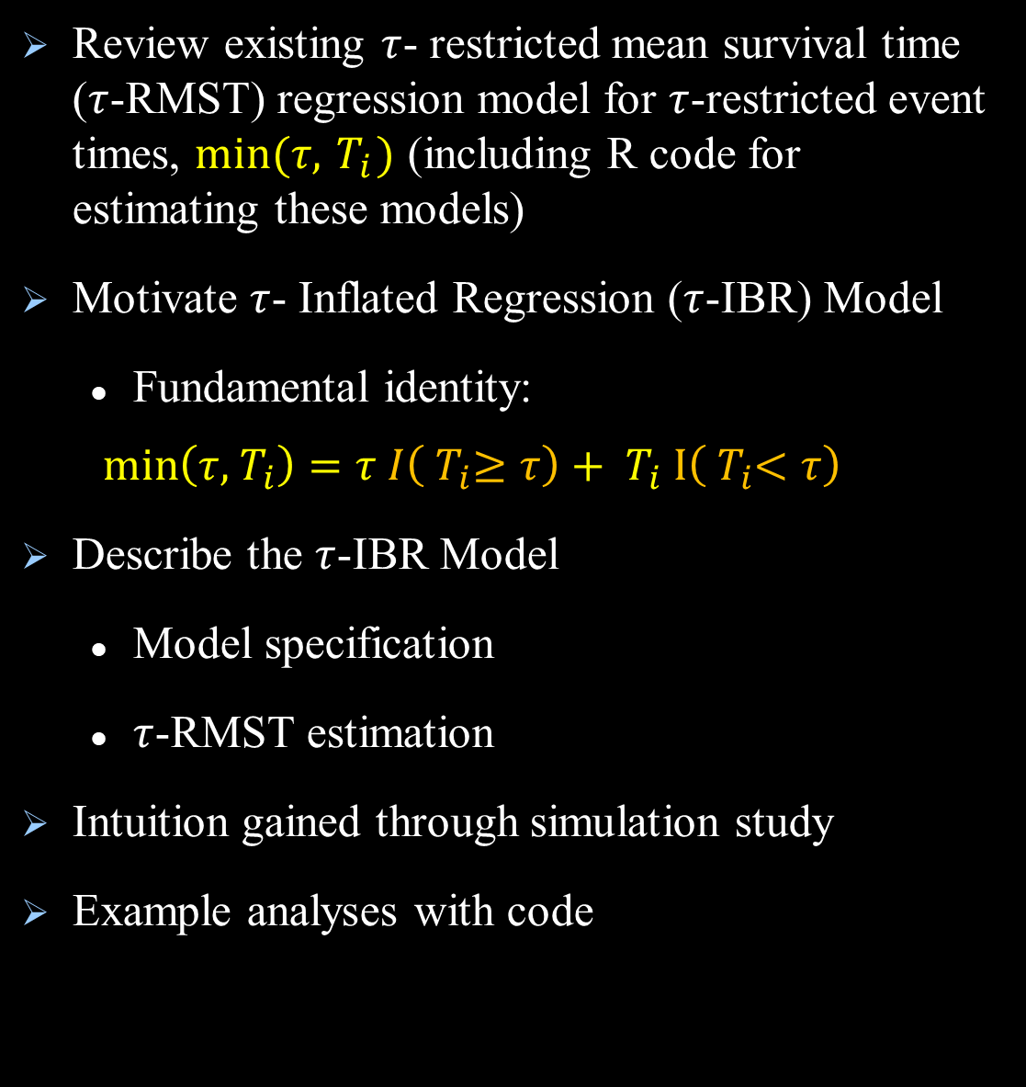
Goals for this presentation
Review existing $τ$- restricted mean survival time ($τ$-RMST) regression model for $τ$-restricted event times, $min⁡(τ, { T}_{i})$ (including R code for estimating these models)
Motivate $τ$- Inflated Regression ($τ$-IBR) Model
Fundamental identity:
$$\min\left(τ, { T}_{i}\right)=τ I\left({ T}_{i}≥τ\right)+{ T}_{i} I\left({ T}_{i}<τ\right)$$
Describe the $τ$-IBR Model
Model specification
$τ$-RMST estimation
Intuition gained through simulation study
Example analyses with code

Slide 3
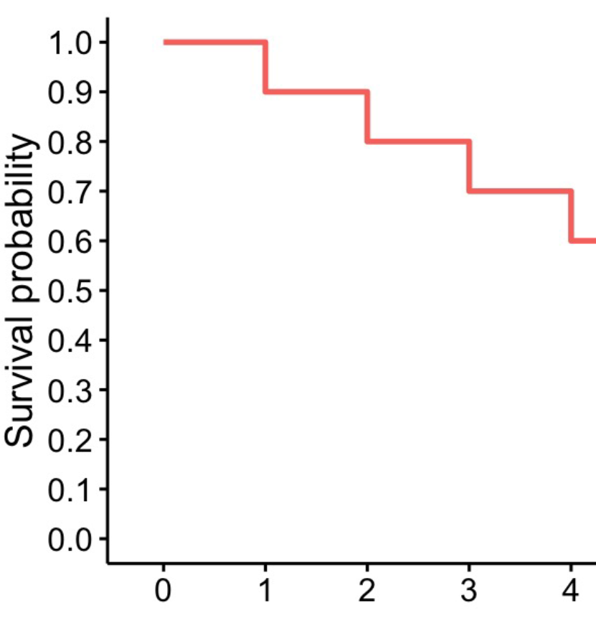




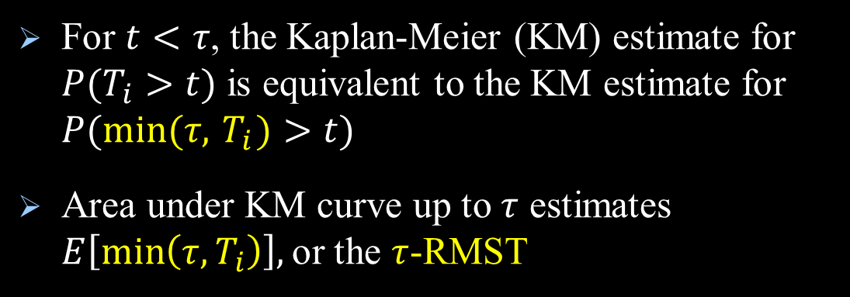
$τ$-Restricted Event Times, $min⁡(τ, { T}_{i})$
We work with these event times nearly always
Finite follow-up periods common
Suppose $τ=$ largest observed follow-up time
For $t<τ$, the Kaplan-Meier (KM) estimate for $P(T_{i}>t)$ is equivalent to the KM estimate for $P(min⁡(τ, { T}_{i})>t)$
Area under KM curve up to $τ$ estimates $E\left[\min\left(τ,T_{i}\right)\right],$or the $τ$-RMST
Notes:
$τ$ must be in the range of the observed data, but it can be user specified within that range.

Slide 4

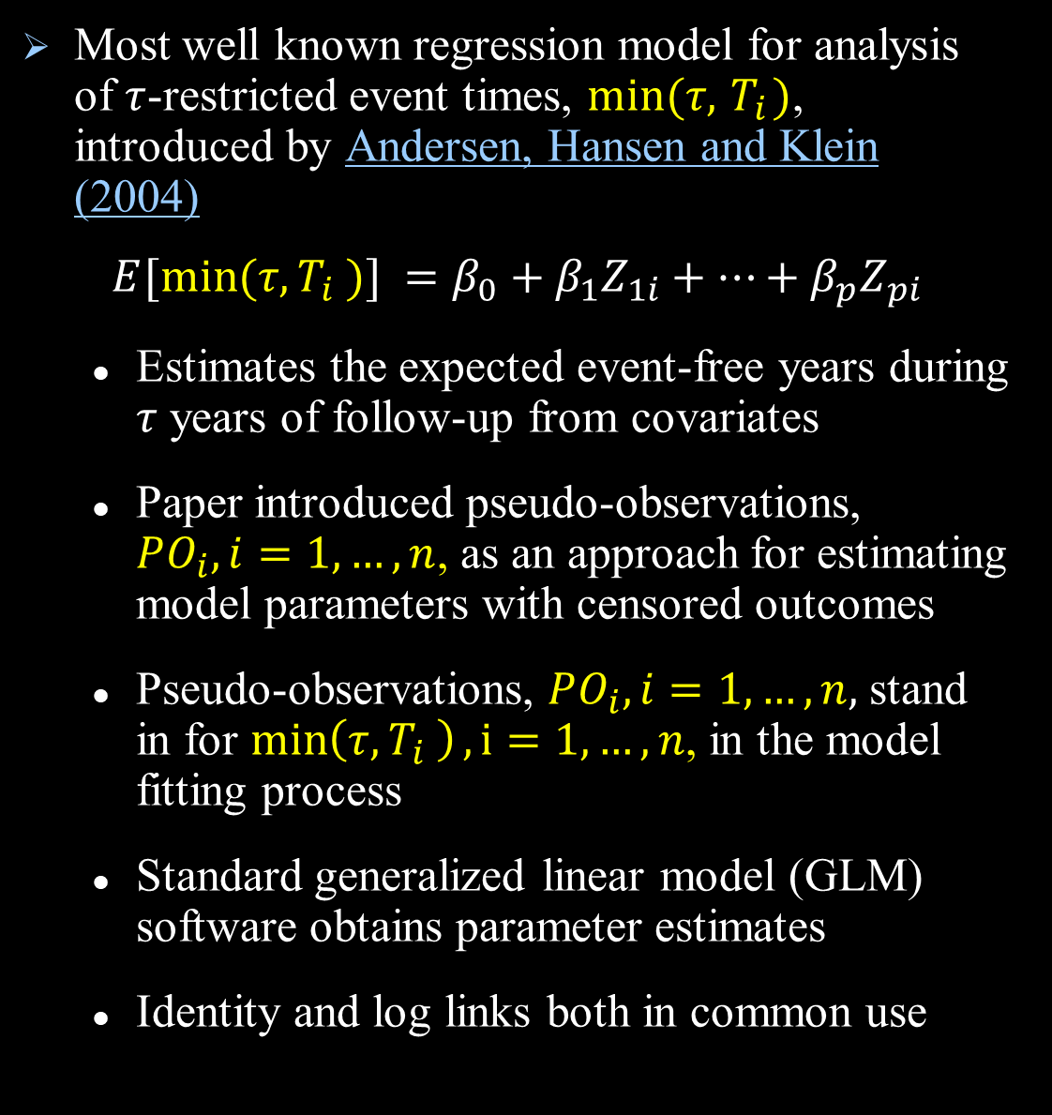
$τ$-RMST Regression Model
Most well known regression model for analysis of $τ$-restricted event times, $min⁡(τ, { T}_{i})$, introduced by Andersen, Hansen and Klein (2004)
$$E[min⁡(τ, T_{i} )] =β_{0}+β_{1}Z_{1i}+⋯+β_{p}Z_{pi}$$
Estimates the expected event-free years during $τ$ years of follow-up from covariates
Paper introduced pseudo-observations, $PO_{i}, i=1,…,n$, as an approach for estimating model parameters with censored outcomes
Pseudo-observations, $PO_{i}, i=1,…,n,$ stand in for $\min\left(τ, T_{i} \right), i=1,…,n$, in the model fitting process
Standard generalized linear model (GLM) software obtains parameter estimates
Identity and log links both in common use
Notes:
Different user-specified link functions can be used, as with all GLM models
GEE approach thought to add a degree of robustness to variance calculations even with one pseudo-observation per individual (some software packages seem to do this). However, in my own research, I haven’t seen much difference in simulated performance when using simpler GLM models with a single time-to-event outcome. Either approach seems fine.

Slide 5
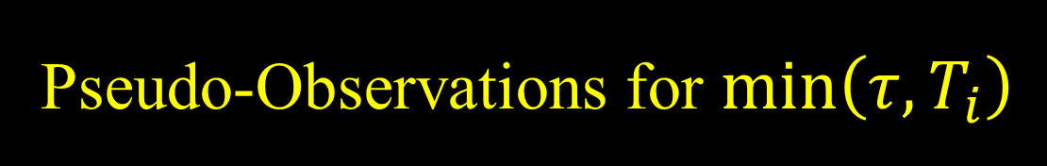
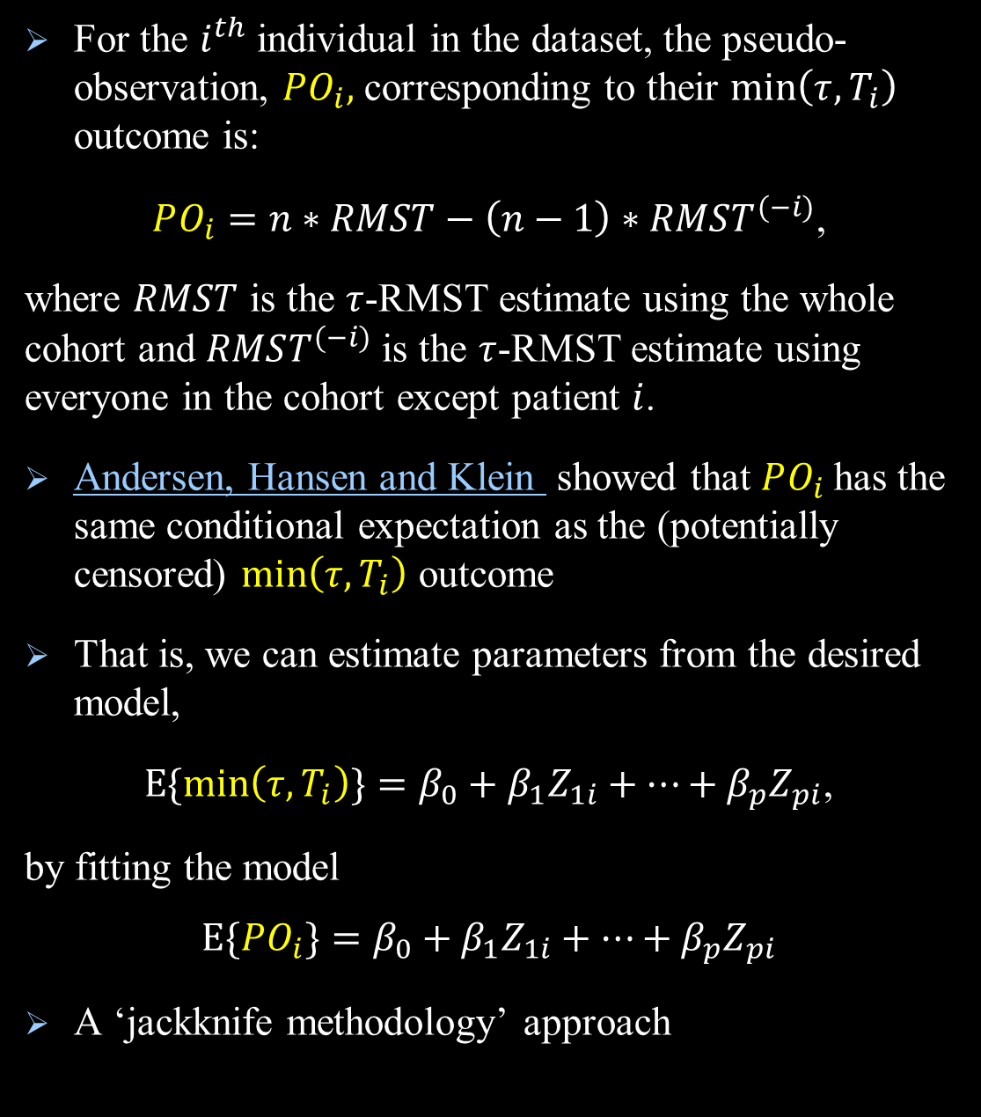
Pseudo-Observations for $\min\left(τ, T_{i}\right)$
For the $i^{th}$individual in the dataset, the pseudo-observation, $PO_{i},$corresponding to their $\min\left(τ, T_{i}\right)$ outcome is:
$PO_{i}=n∗RMST−\left(n−1\right)∗RMST^{(−i)}$,
where $RMST$ is the $τ$-RMST estimate using the whole cohort and $RMST^{(−i)}$is the $τ$-RMST estimate using everyone in the cohort except patient $i$.
Andersen, Hansen and Klein showed that $PO_{i}$has the same conditional expectation as the (potentially censored) $\min\left(τ, T_{i}\right)$ outcome
That is, we can estimate parameters from the desired model,
$E\{min\left(τ, T_{i}\right)\}=β_{0}+β_{1}Z_{1i}+⋯+β_{p}Z_{pi}$,
by fitting the model
$$E\{PO_{i}{\}}=β_{0}+β_{1}Z_{1i}+⋯+β_{p}Z_{pi}$$
A ‘jackknife methodology’ approach
Notes:
$RMST$ and $RMST^{(−i)}$ are based on area under Kaplan-Meier estimate up to $τ$, which we can obtain even when $\min\left(τ, T_{i}\right)$ outcomes are censored.
When there are censored observations, pseudo- observations have the same conditional expectation as the original data values, but are not necessarily consistent with the observed data.
-Pseudo-values may be smaller than or greater than observed event times.
-Pseudo-values may be less than observed censoring times.
-Don’t worry too much about this…these issues average out across the dataset and the parameter estimates are valid!

Slide 6


Maximum Possible $τ$ When Using Pseudo-Observations
$PO_{i}=n∗RMST−\left(n−1\right)∗RMST^{(−i)}$,
where $RMST$ is the $τ$-RMST based on whole cohort and $RMST^{(−i)}$is the $τ$-RMST based on whole cohort without patient $i$.
$τ$ must be a valid choice for estimating $RMST^{(−i)}$ for $i=1,…,n.$
At least one of the two largest event times is included in $RMST^{(−i)}$. So, when figuring out the maximum possible $τ$, you only need to think about these two values.
No restriction on $τ$ if largest two event times are both deaths.
If both of the largest two event times are censored, then the maximum possible $τ$ is the smaller of these two values.
If only one of the largest two event times is censored, then the maximum possible $τ$ is this value.
Notes:
One of the two largest event times is always included in $RMST^{(−i)}$. So when figuring the maximum possible $τ$ need only consider these two values

Slide 7

Example: Azithromycin for Prevention of Chronic Obstructive Pulmonary Disease (COPD) Exacerbations Trial
Patients were randomized to azithromycin or placebo.
Followed for the primary endpoint of time-to-first acute exacerbation during the subsequent year.
A 1-year-RMST model estimates acute exacerbation-free days over the follow-up year by treatment group and other patient characteristics
For $τ=1$, equivalent to interpret parameters as (absolute) increase in the percent exacerbation-free time during the 1-unit follow-up period corresponding to a 1-unit increase in the predictor
Advantage to rescaling outcomes from (0, $τ$] scale to (0,1] scale when interpreting results

Slide 8
Example: Azithromycin for Prevention of Chronic Obstructive Pulmonary Disease (COPD) Exacerbations Trial
Variables in ex_data_example.csv:
X= observed follow-up days on study
Delta=1 if follow-up time, X, corresponds to an exacerbation, 0 otherwise
trt = 1 if azithromycin, 0 otherwise
age_10_new = age in decades, centered around 65 years
gender=1 if male, 0 otherwise
fev1_10_new = FEV1 per 10% predicted, centered around 40% of predicted
nowsmk=1 if current smoker, 0 otherwise
Site indicator variables: latitude_34, latitude_38, latitude_39, latitude_40, latitude_42, latitude_44
Notes:
A lot of the upcoming code rescales X to be in years, not days $(τ=1$oriented analysis). Good to be clear on units in interpreting results.

Slide 9
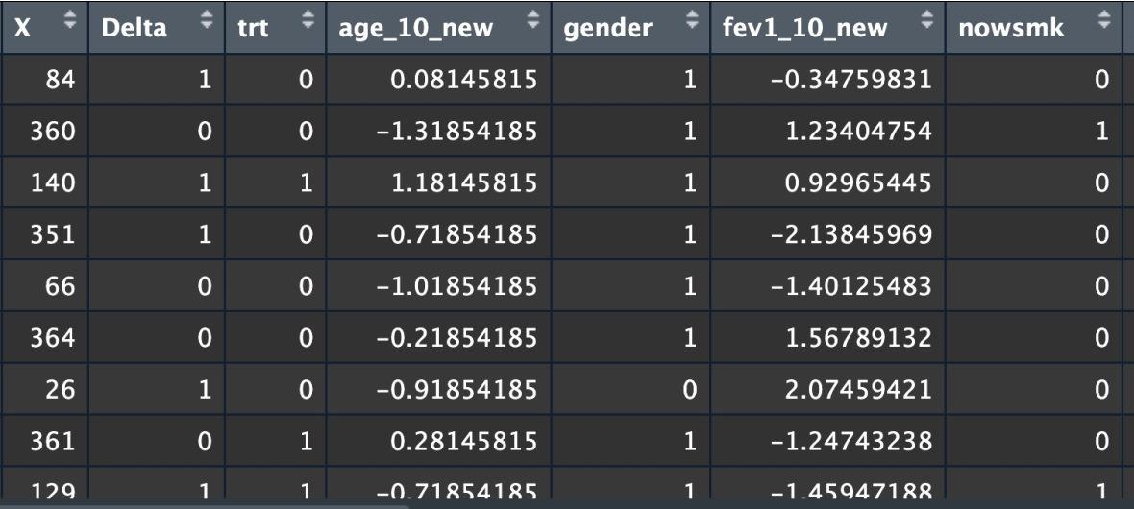

R Code for $τ$-RMST Model (Read in Data)
Data_cens<- read.csv(“ex_data_example.csv")
#Key data shown below (except for site indicator variables)
Notes:
I cropped out site variables (latitude variables) from the snapshot of the data…

Slide 10
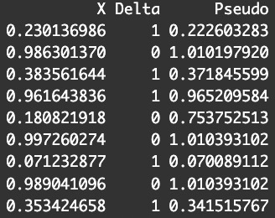
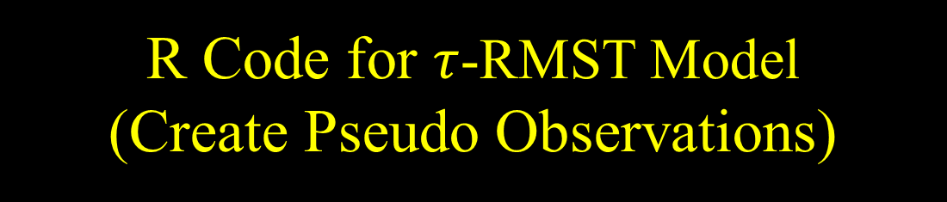

R Code for $τ$-RMST Model (Create Pseudo Observations)
library(pseudo)
set.seed(1234)
tau= 365
#Create pseudo-observations
pseudo <- pseudomean(Data_cens$X,
Data_cens$Delta,
tmax = tau)
#Showing outcomes on year scale: head(cbind(X=Data_cens$X/tau,
Delta=Data_cens$Delta,
Pseudo=pseudo/tau), 10)
Pseudo-observations have the same conditional expectation as uncensored data values would have, but don’t necessarily look like the uncensored outcomes of interest.
$$⋮$$
Notes:
When there are censored observations, pseudo- observations have the same conditional expectation as the original data values, but are not necessarily consistent with the observed data.
-Pseudo-values may be smaller than or greater than observed event times.
-Pseudo-values may be less than observed censoring times.
-Don’t worry too much about this…these issues average out across the dataset and the parameter estimates are valid!

Slide 11
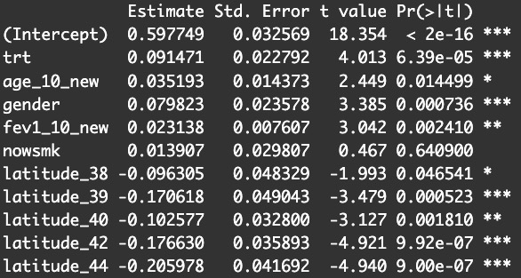
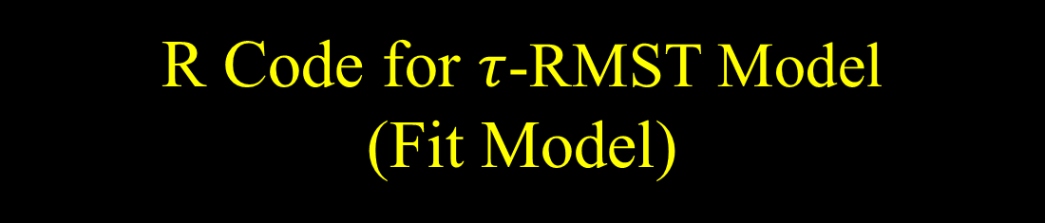
R Code for $τ$-RMST Model (Fit Model)
library(stats)
pseudo_fit <- lm(pseudo/tau~
trt+
age_10_new+
gender+
fev1_10_new+
nowsmk+ latitude_38+latitude_39+latitude_40+
latitude_42+latitude_44,data=Data_cens)
summary(pseudo_fit)

Slide 12
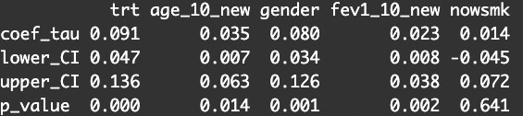
Manuscript Friendly Results With Coefficients, 95% CIs, P-values
coefs<-pseudo_fit$coefficients
se_coefs<-coef(summary(pseudo_fit))[, 2]
pvals<-as.numeric(
summary(pseudo_fit)$coefficients[,4]) CI_RMST_lower<- coefs -1.96*se_coefs CI_RMST_upper<- coefs +1.96*se_coefs RMST_model_results<-rbind((coefs)[2:6], (CI_RMST_lower)[2:6], (CI_RMST_upper)[2:6],
(pvals)[2:6]) round(RMST_model_results,digits=3)

Slide 13
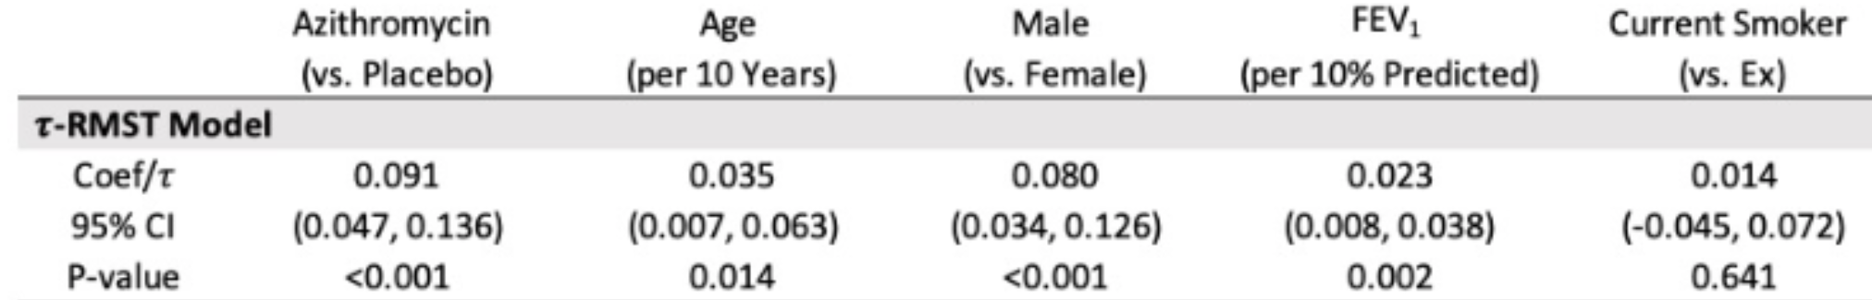
Example: Azithromycin for Prevention of Chronic Obstructive Pulmonary Disease (COPD) Exacerbations Trial
Results are additionally adjusted for the study site (data not shown)
During the year on study, the percentage of time spent exacerbation-free was estimated to be 9.1% longer when taking azithromycin versus placebo (95% CI 4.7-13.6% longer; p<0.001), when adjusted for age, sex, FEV1 % predicted, current smoking status and site.

Slide 14

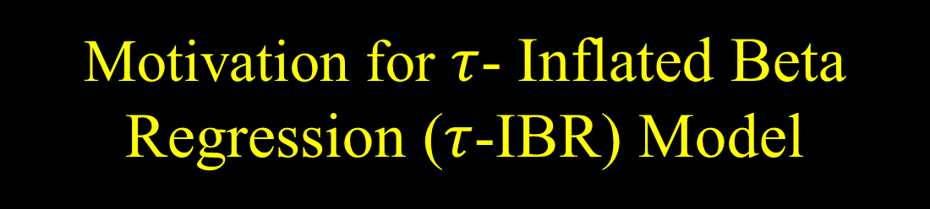
Motivation for $τ$- Inflated Beta Regression ($τ$-IBR) Model
Fundamental identity:
$$\min\left(τ, { T}_{i}\right)=τ I\left({ T}_{i}≥τ\right)+{ T}_{i} I\left({ T}_{i}<τ\right)$$
is a mixture random variable that can be rewritten in terms of
$B_{i}=I\left(T_{i}≥τ\right)∼$Bernoulli($π_{i}$) with mean, $π_{i}=P\left({ T}_{i}≥τ\right)$
and
${\begin{aligned} \\ Y\end{aligned}}_{i}=\frac{{ T}_{i}}{τ}$ given ${ T}_{i}<τ$,
which we will assume follows a beta$[μ_{i}ν,\left(1−μ_{i}\right)ν]$ distribution with mean, $μ_{i}$.
In terms of these random variables,
$$\min\left(τ, { T}_{i}\right) =τ\left[B_{i}+{ Y}_{i}\left(1−B_{i}\right)\right]$$
Suggests modeling of $B_{i}$ and${ Y}_{i}$ as alternative to $τ$-RMST model

Slide 15
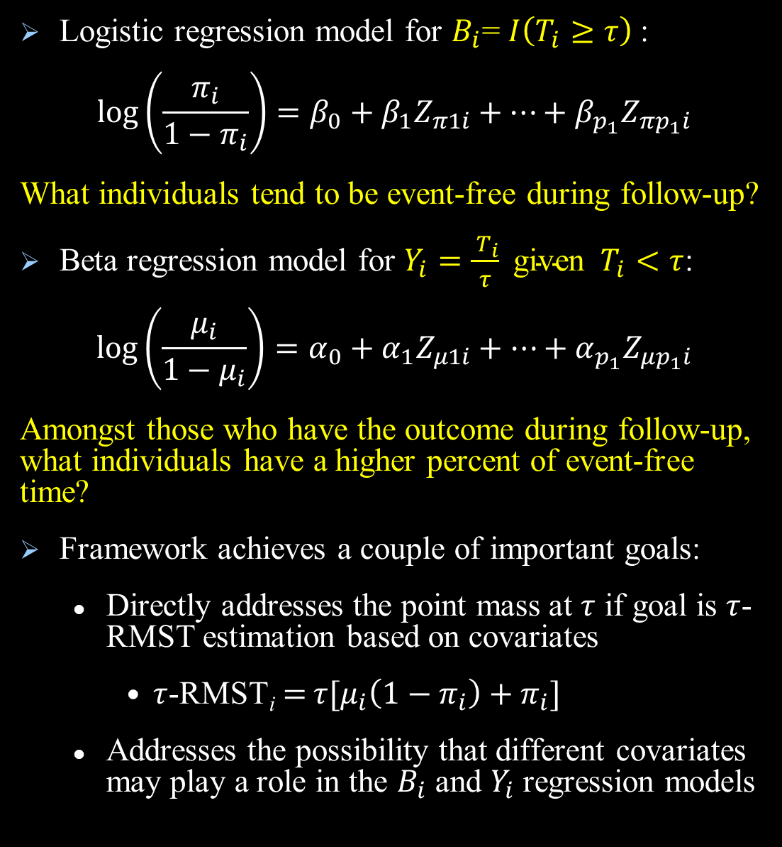

Components of $τ$-IBR Model
Logistic regression model for $B_{i}$= $I\left(T_{i}≥τ\right)$:
$$\log\left(\frac{π_{i}}{1−π_{i}}\right)=β_{0}+β_{1}Z_{π1i}+⋯+β_{p_{1}}Z_{πp_{1}i}$$
What individuals tend to be event-free during follow-up?
Beta regression model for $Y_{i}=\frac{{ T}_{i}}{τ} \text{given} { T}_{i}<τ$:
$$\log\left(\frac{μ_{i}}{1−μ_{i}}\right)=α_{0}+α_{1}Z_{μ1i}+⋯+α_{p_{1}}Z_{μp_{1}i}$$
Amongst those who have the outcome during follow-up, what individuals have a higher percent of event-free time?
Framework achieves a couple of important goals:
Directly addresses the point mass at $τ$ if goal is $τ$-RMST estimation based on covariates
$τ$-RMST_{i}$=$ $τ[μ_{i}\left(1−π_{i}\right)+π_{i}]$
Addresses the possibility that different covariates may play a role in the $B_{i}$ and $Y_{i}$ regression models

Slide 16

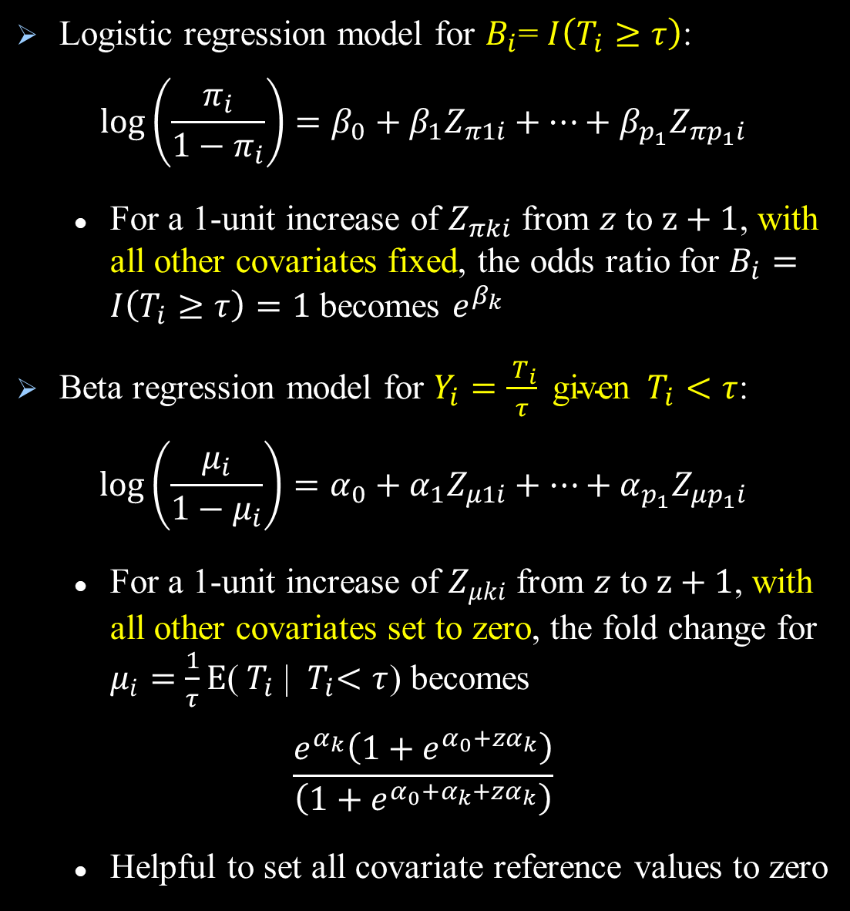
Interpreting Coefficients from $τ$-IBR Model
Logistic regression model for $B_{i}$= $I\left(T_{i}≥τ\right)$:
$$\log\left(\frac{π_{i}}{1−π_{i}}\right)=β_{0}+β_{1}Z_{π1i}+⋯+β_{p_{1}}Z_{πp_{1}i}$$
For a 1-unit increase of $Z_{πki}$ from $z$ to $z+1$, with all other covariates fixed, the odds ratio for $B_{i}=I\left(T_{i}≥τ\right)=1$ becomes $e^{β_{k}}$
Beta regression model for $Y_{i}=\frac{{ T}_{i}}{τ} \text{given} { T}_{i}<τ$:
$$\log\left(\frac{μ_{i}}{1−μ_{i}}\right)=α_{0}+α_{1}Z_{μ1i}+⋯+α_{p_{1}}Z_{μp_{1}i}$$
For a 1-unit increase of $Z_{μki}$ from $z$ to $z+1$, with all other covariates set to zero, the fold change for $μ_{i}=\frac{1}{τ}E$(${ T}_{i}$| ${ T}_{i}<τ$) becomes
$$\frac{e^{α_{k}}\left(1+e^{α_{0}+zα_{k}}\right)}{\left(1+e^{α_{0}+α_{k}+zα_{k}}\right)}$$
Helpful to set all covariate reference values to zero
Notes:
This interpretation for beta model parameters is why we suggest centering covariates around zero.

Slide 17

Censoring Addressed by Fitting Models Using One of Two Approaches
Approach 1: Estimation-maximization (EM)
Approach 2: Inverse-transform multiple imputation (MI) to fill in missing information for censored outcomes
Defines risk sets of similar individuals to censored individual in terms of $(μ_{i},π_{i})$ and nonparametrically samples missing residual lifetime from risk set’s KM estimate
M complete datasets obtained via MI algorithm
Results combined across imputed datasets via Rubin’s rules (Little and Rubin, 1987. Analysis with missing data. JohnWiley & Sons.)
Technical details omitted, but both EM and MI approaches work well
MI approach allows for additional analyses, plots
Notes:
Consider adding in graphical summary of MI if time permits

Slide 18

Learning Through Simulation
Setting:
n=1000, $τ=30$
Independent covariates, where $Z_{1i}∼Unif(0,1)$, $Z_{2i}∼Bernoulli(0.7)$, $Z_{3i}∼Unif(0,1)$
Logistic regression model for $B_{i}$:
$$\log\left(\frac{π_{i}}{1−π_{i}}\right)=−1.0+1.0Z_{1i}+2.0Z_{2i}−1.5Z_{3i}$$
Beta regression model for $Y_{i}$:
$$\log\left(\frac{μ_{i}}{1−μ_{i}}\right)=−2.0+1.2Z_{1i}+2.0Z_{2i}$$
Approximately 52% of simulated individuals would have $\min\left(30, T_{i}\right)=30,$ if uncensored
Independent censoring generated so that approximately 30% censoring of events prior to 30.

Slide 19
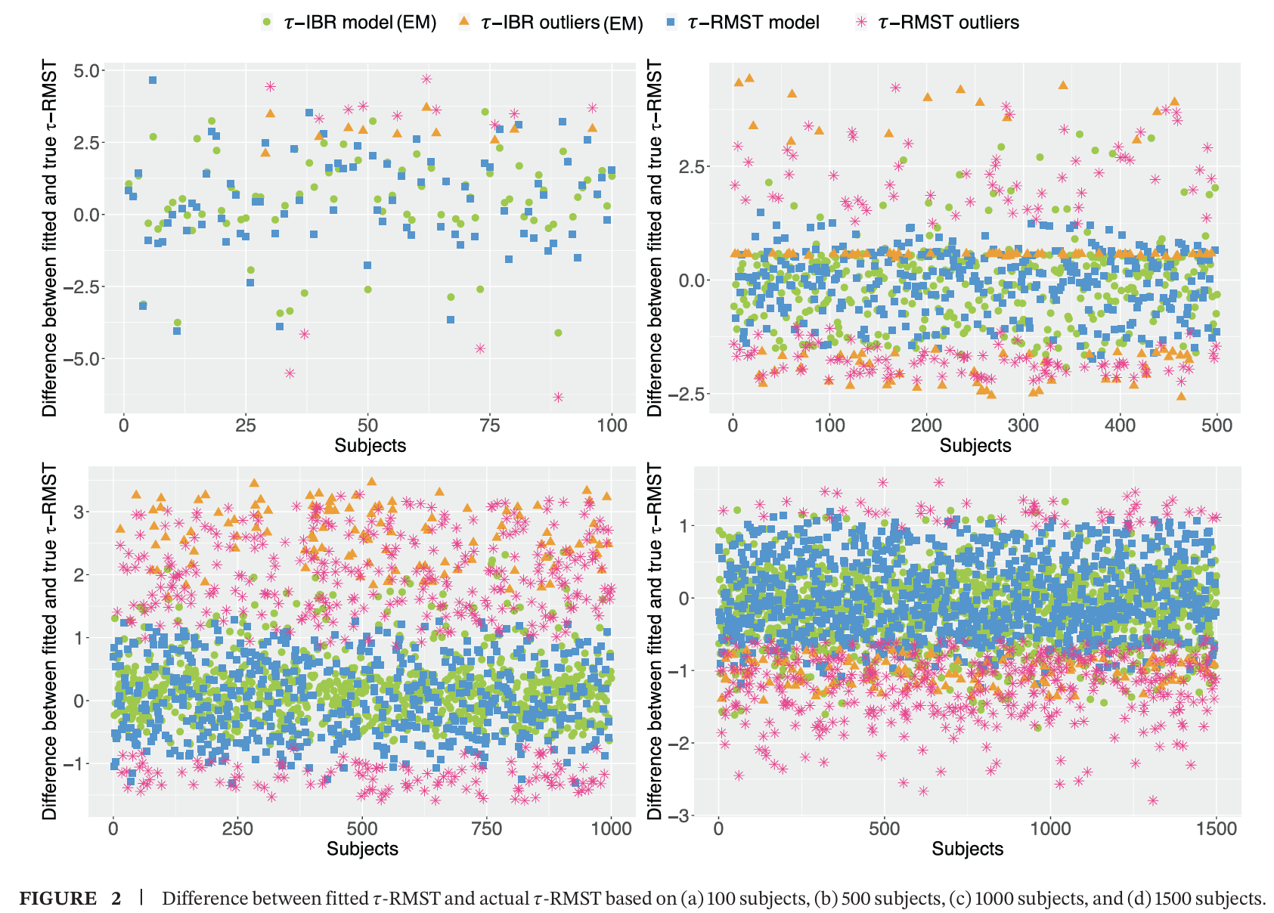


Key Simulation Findings
Both $τ$-IBR and standard $τ$-RMST models gave unbiased estimates for $E\{min\left(τ, T_{i}\right)\}$
However, $τ$-IBR estimates were more precise and had better coverage probabilities t$han τ$-RMST estimates
Both models perform similarly if there are no important covariates in the logistic component of the $τ$-IBR model
Notes:
Differences between estimated and true 𝜏-RMST values for representative datasets with n = 100, 500, 1000, and1500 subjects (data shown for n=1000). Outliers are subjects whose true 𝜏-RMST values were not covered by each method’s estimated 95% CIs. Although the average bias is near zero for the standard 𝜏-RMST model estimates in this Figure, high absolute bias is seen in many cases due to not taking into account the behavior of the point mass of min(𝜏,𝑇𝑖) at 𝜏. Hence, in very plausible settings where the point mass at 𝜏 contains important statistical information about the restricted event time, we see significant gains in precision using the more suitable 𝜏-IBR modeling approach.

Slide 20


$τ$-IBR Example: Azithromycin for Prevention of Chronic Obstructive Pulmonary Disease (COPD) Exacerbations Trial
One feature of the $τ$-IBR MI algorithm is that we obtain multiple completed datasets of $min\left(τ, T_{i}\right)$ outcomes.
This allows us to plot data using methods available for uncensored outcomes (see heatmap).

Slide 21
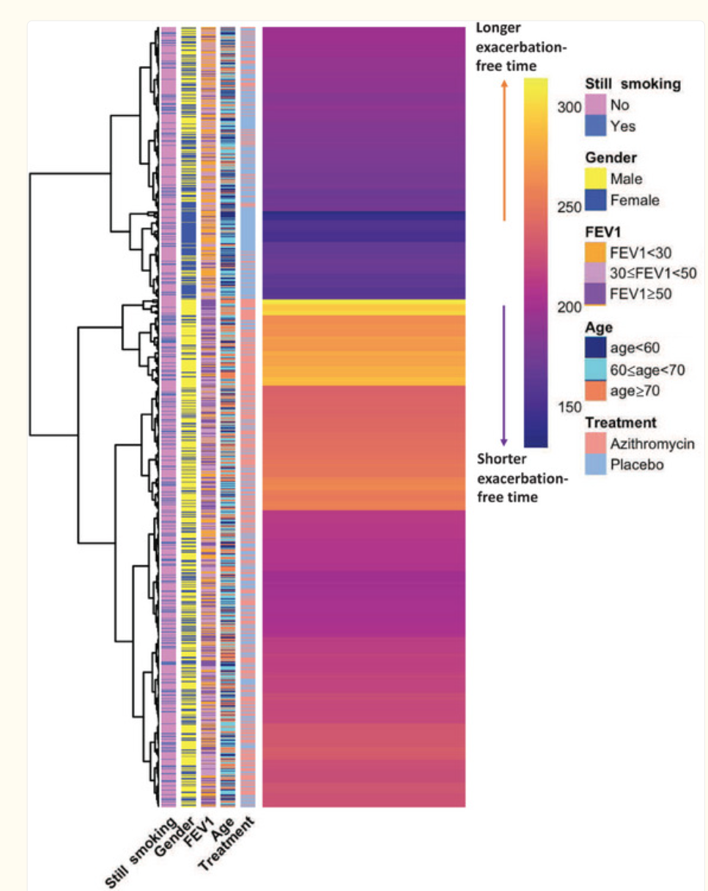
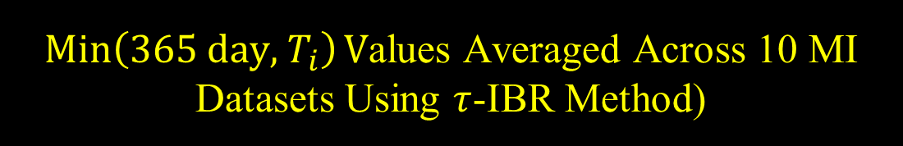
$\operatorname{Min}\left(365 day, { T}_{i}\right)V$alues Averaged Across 10 MI Datasets Using $τ$-IBR Method)
Shorter
Longer
150 200 250 300
Avg Exacerbation-free Days during Follow-up
Notes:
Arrows for longer and shorter exacerbation-free time refer to heat map color scale (dark purple is shortest exacerbation-free time).
Heatmap entries are individual $\min\left(365 day, { T}_{i}\right)$ values averaged across 10 imputed datasets, with higher values in the yellow color range and lower values in the purple color range. Additional individual characteristics (treatment, age, gender, FEV1% of predicted and smoking status) are color coded along the left side of the heatmap. Descriptively, the cluster with the highest values is more likely to be taking azithromycin, is predominantly male, and tends to have FEV1% >50% of predicted. The cluster with the lowest values is more likely to be taking placebo, is predominantly female and tends to have FEV1% < 30% of predicted.
Yizhuo uploaded code she used to create heatmap on github
(Manuscript labeled these RMST values, but they are the raw data with censored data filled in and averaged over 10 imputes)

Slide 22

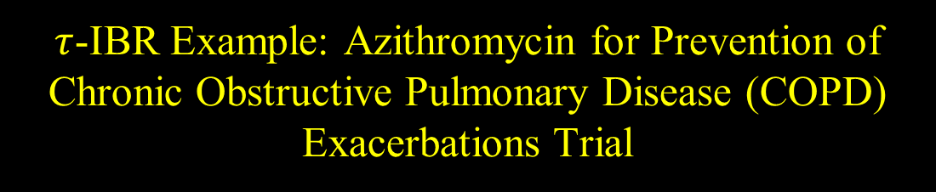
$τ$-IBR Example: Azithromycin for Prevention of Chronic Obstructive Pulmonary Disease (COPD) Exacerbations Trial
Fitted Models:
Logistic regression model for $B_{i}$:
$$\log\left(\frac{π_{i}}{1−π_{i}}\right)=−0.681+0.558trt+0.130age_10_new$$
$$+0.497gender+0.113\text{fev}\text{_10_}\text{new}$$
$+0.076\text{nowsmk}$+site variable results
Beta regression model for $Y_{i}$:
$$\log\left(\frac{μ_{i}}{1−μ_{i}}\right)=−0.332+0.038trt+0.116age_10_new$$
$$+0.049gender+0.\text{033}\text{fev}\text{_10_}\text{new}$$
$$+0.0\text{01}\text{nowsmk}\text{+}\text{site} \text{variable} \text{results}$$

Slide 23
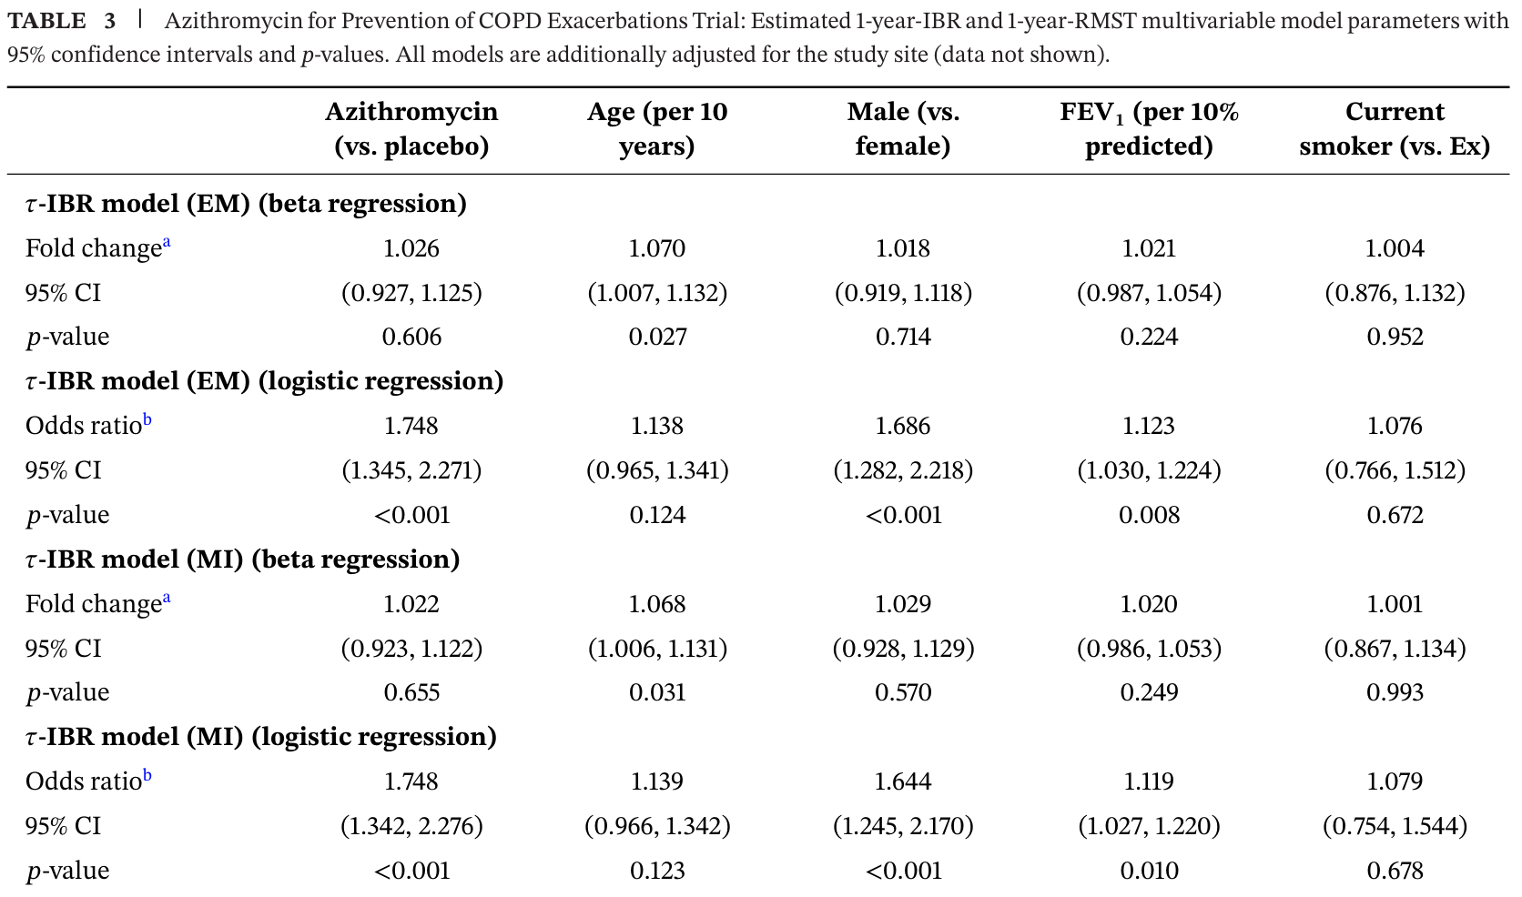
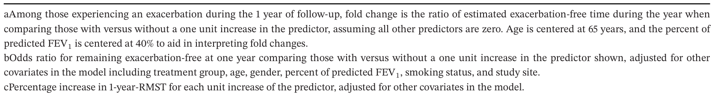


Manuscript Presentation of Results (Beta Regression Model for $Y_{i}$)
Fold change for trt going from $z$=0 to 1 from MI beta regression model:
$\frac{e^{α_{k}}\left(1+e^{α_{0}+zα_{k}}\right)}{\left(1+e^{α_{0}+α_{k}+zα_{k}}\right)}$ $=\frac{e^{0.038}\left(1+e^{−0.332}\right)}{\left(1+e^{−0.332+0.038}\right)}=1.022$
Amongst those with exacerbations during the year, azithromycin did not significantly increase the percentage of exacerbation-free time during that period (MI: fold change of 1.022 longer exacerbation-free time comparing azithromycin to placebo and adjusted for other factors in the model, 95% CI: 0.923–1.122, p = 0.655).

Slide 24


Manuscript Presentation of Results (Logistic Regression Model for $B_{i}$)
Odds ratio for trt going from $z$=0 to 1 from MI logistic regression model:
$e^{β_{k}}=e^{0.558}=1.748$
The odds of remaining exacerbation-free at 1 year were significantly higher when taking azithromycin versus placebo, adjusted for other factors in the model (1.748, 95% CI: 1.342–2.276, p < 0.001).

Slide 25
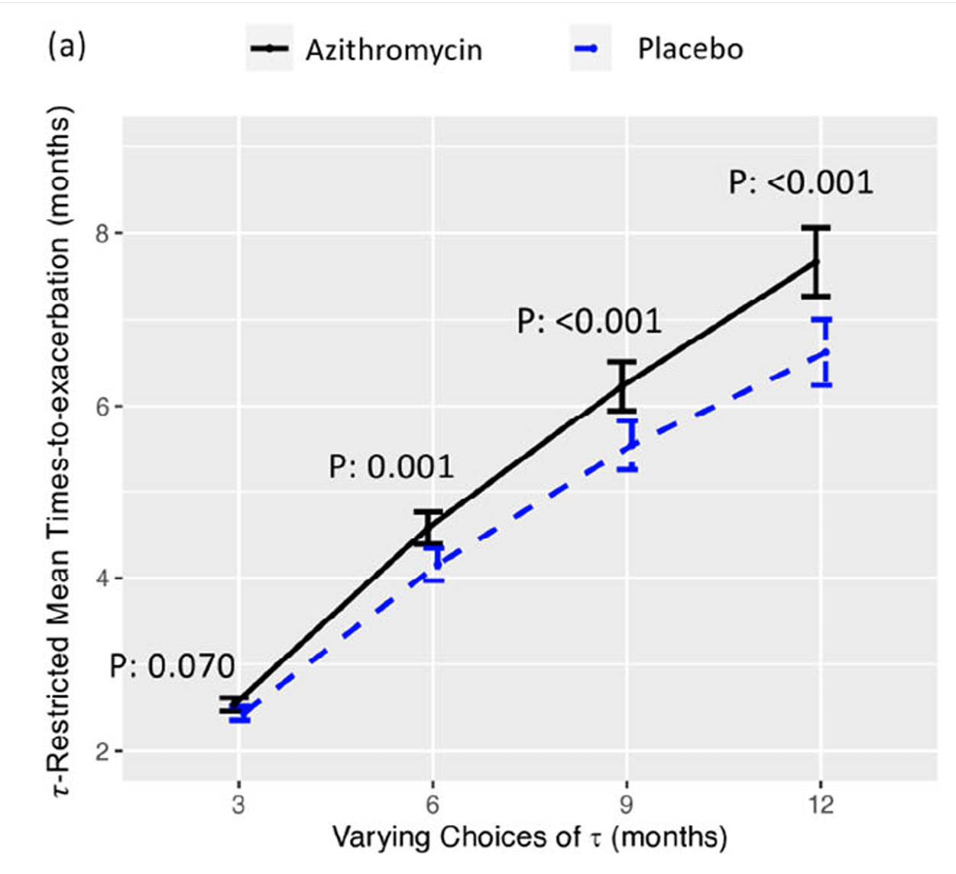
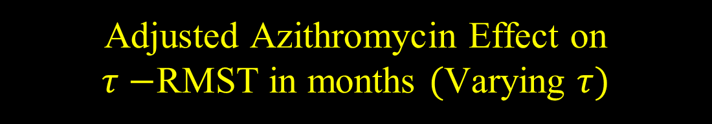

Adjusted Azithromycin Effect on $τ−$RMST in months $($Varying $τ)$
Results based on $τ$-IBR model fit using MI approach and assuming average cohort values for confounders: age 65 years, 59% probability of male, 40% FEV1 % predicted, 22% chance of being a current smoker and study site probabilities (not shown).
Notes:
MI results shown here

Slide 26
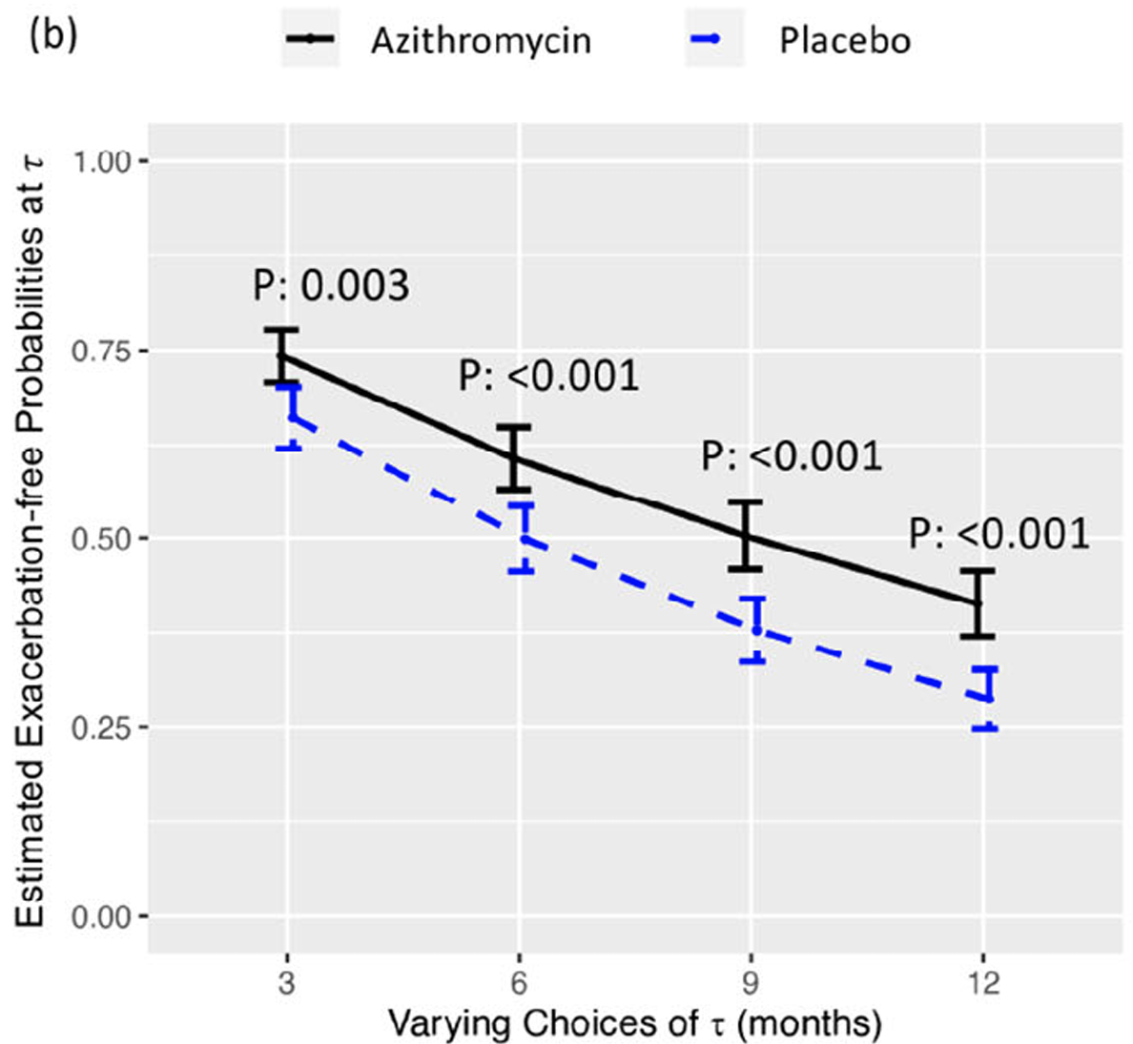

Adjusted Azithromycin Effect on Exacerbation-free Probabilities at $τ$ $($Varying $τ)$
Results based on $τ$-IBR model fit using MI approach and assuming average cohort values for confounders: age 65 years, 59% probability of male, 40% FEV1 % predicted, 22% chance of being a current smoker and study site probabilities (not shown).
Notes:
MI results shown here

Slide 27
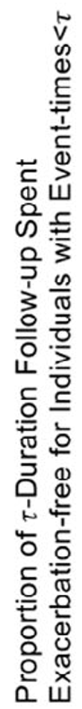
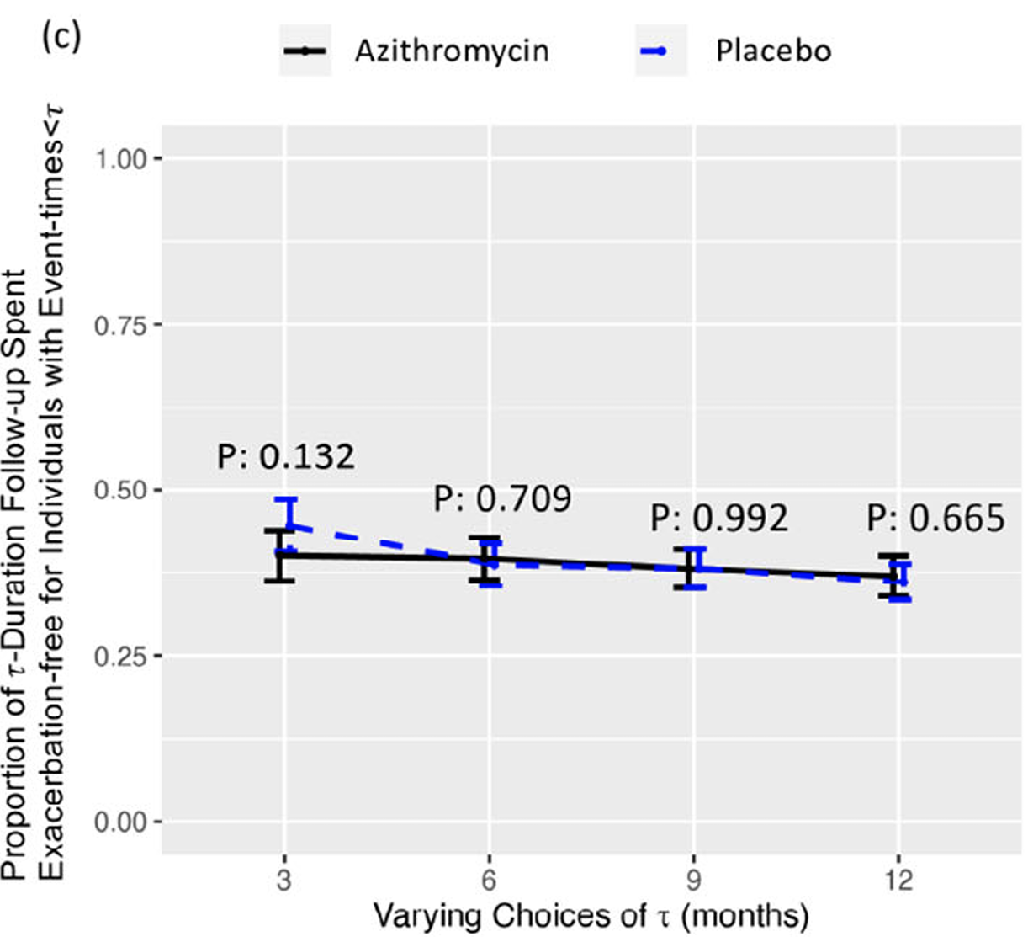
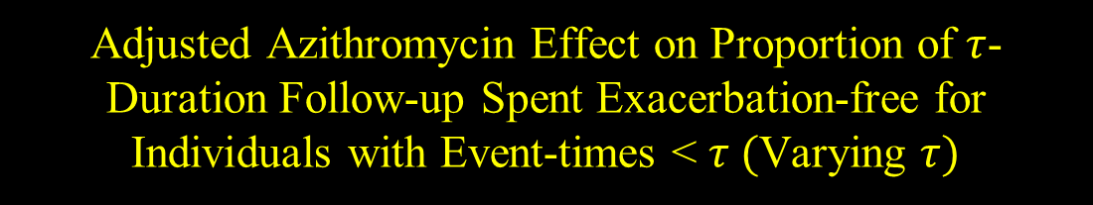
Adjusted Azithromycin Effect on Proportion of $τ$-Duration Follow-up Spent Exacerbation-free for Individuals with Event-times < $τ ($Varying $τ)$
Results based on $τ$-IBR model fit using MI approach and assuming average cohort values for confounders: age 65 years, 59% probability of male, 40% FEV1 % predicted, 22% chance of being a current smoker and study site probabilities (not shown).
Notes:
MI results shown here

Slide 28
How to Use Github Site for Ann Arbor ASA Meeting 1-28-2025
Go to Ann Arbor ASA Meeting Github Site: https://github.com/yezow/tau-IBR_ASA
Create a folder with the following :
Dataset: ex_data_example.csv
Paper1_func.R
MI_function.R
Your current R code file
Following code should work with R Studio

Slide 29
Load a Few R Packages
library(foreach) library(doParallel) library(parallel) library(boot) library(purrr) library(survival) library(survminer) library(data.table) library(survRM2) library(coda) library(numDeriv) library(matrixStats) library(betareg) library(simcausal) library(latex2exp) library(dplyr) library(base) library(eoffice) library(ggplotify) library(gridExtra) library(cowplot) library(pheatmap) library(viridis) library(RColorBrewer) library(ggplot2) library(tikzDevice) library(ggpubr) library(grid)
Notes:
Note sure which of these are actually needed lol

Slide 30
Data Preparation
options(warn=0) #keep running the code with warnings current_path = rstudioapi::getActiveDocumentContext()$path setwd(dirname(current_path ))
#X and Delta variables must use these variable names
#Need to define all variables in mu model
Z_mu <- data.matrix(dplyr::select(Data_cens,
trt,
age_10_new,
gender,
fev1_10_new,
nowsmk,
latitude_38,latitude_39,latitude_40,
latitude_42,latitude_44))
Z_mu_length=ncol(Z_mu)
# Need to define all variables in pi model (same for this example, but need not be)
Z_pi <- Z_mu
Z_pi_length=ncol(Z_pi)
nsubj<-nrow(Z_mu)
#rows that need multiple imputation
row_MI <- which(Data_cens$X<tau & Data_cens$Delta==0)

Slide 31

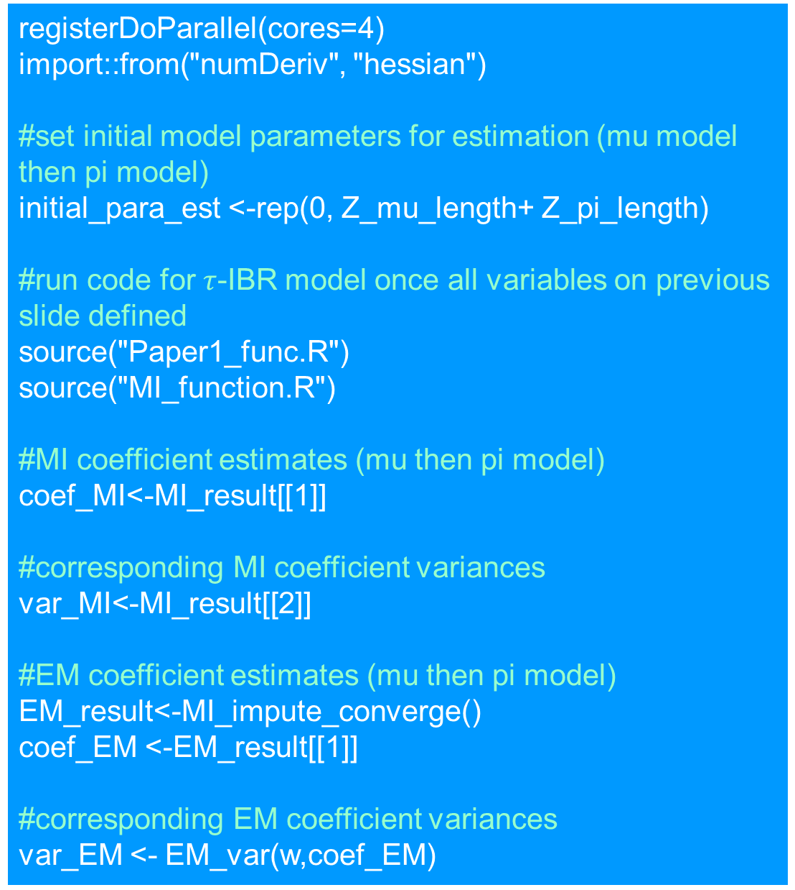
Fitting $τ$-IBR model
registerDoParallel(cores=4)
import::from("numDeriv", "hessian")
#set initial model parameters for estimation (mu model then pi model)
initial_para_est <-rep(0, Z_mu_length+ Z_pi_length)
#run code for $τ$-IBR model once all variables on previous slide defined
source("Paper1_func.R")
source("MI_function.R")
#MI coefficient estimates (mu then pi model)
coef_MI<-MI_result[[1]]
#corresponding MI coefficient variances
var_MI<-MI_result[[2]]
#EM coefficient estimates (mu then pi model)
EM_result<-MI_impute_converge()
coef_EM <-EM_result[[1]]
#corresponding EM coefficient variances
var_EM <- EM_var(w,coef_EM)

Slide 32
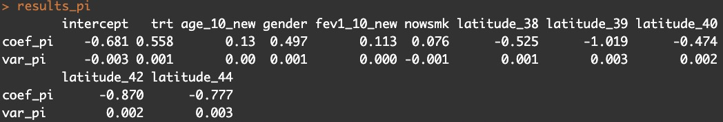
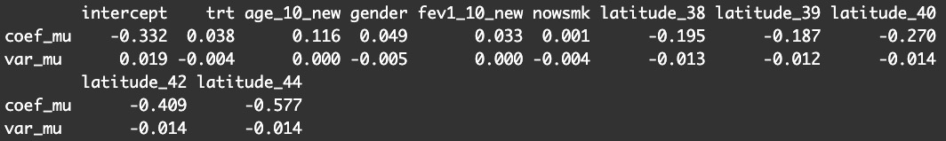
MI Model Results
results_pi=round(rbind(coef_pi=coef_MI[(ncol(Z_mu)+2):(ncol(Z_mu)+ncol(Z_pi)+2)],var_pi=var_MI[(ncol(Z_mu)+2):(ncol(Z_mu)+ncol(Z_pi)+2)]),digits=3) colnames(results_pi)=colnames(results_mu) results_pi
results_mu=round(rbind(coef_mu=coef_MI[1:(ncol(Z_mu)+1)],var_mu=var_MI[1:(ncol(Z_mu)+1)]),digits=3) colnames(results_mu)<-c("intercept","trt","age_10_new","gender","fev1_10_new","nowsmk","latitude_38","latitude_39","latitude_40","latitude_42","latitude_44") results_mu

Slide 33
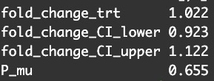
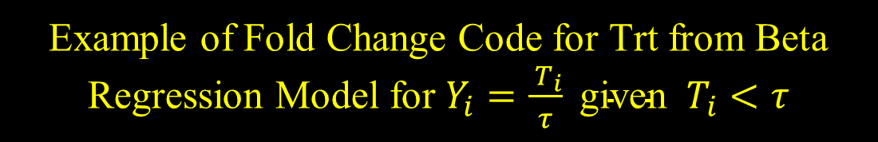
Example of Fold Change Code for Trt from Beta Regression Model for $Y_{i}=\frac{{ T}_{i}}{τ} \text{given} { T}_{i}<τ$
#function called fold_change helps with calculations for MI estimates. E.g. for trt:
fold_change_trt <- fold_change(coef_MI[1:2])
#Corresponding variance var_fold_change_trt <- fold_change_var(coef_MI[1:2],var_MI[1:2,1:2])
#Lower and Upper 95% CI fold_change_CI_lower<-c(fold_change_trt-1.96*sqrt(var_fold_change_trt)) fold_change_CI_upper<-c(fold_change_trt+1.96*sqrt(var_fold_change_trt))
#p-value
P_mu<-2*(1-pnorm(abs(coef_MI[2]),mean=0,sd=sqrt(var_MI[2,2])))
#Display results beta_model_results_trt<-rbind(fold_change_trt, fold_change_CI_lower, fold_change_CI_upper, P_mu) round(beta_model_results_trt, digits=3)
Change highlighted 2’s to covariate position in Z_mu to get results for remaining variables

Slide 34
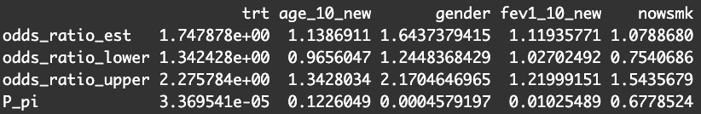

Odds Ratio Results From Logistic Regression Model for $B_{i}$= $I\left(T_{i}≥τ\right)$
pi_model_results<-function(coef,var){ odds_ratio_est<-exp(coef[13:17]) odds_ratio_lower <- numeric() odds_ratio_upper <- numeric() for (j in 13:17){ odds_ratio_lower <- append(odds_ratio_lower,exp(coef[j]-1.96*sqrt(var[j,j]))) odds_ratio_upper <- append(odds_ratio_upper,exp(coef[j]+1.96*sqrt(var[j,j]))) } P_pi<-numeric() for (i in c(13:17)){ P_pi<-append(P_pi,(2*(1-pnorm(abs(coef[i]),mean=0,sd=sqrt(var[i,i]))))) } pi_model_result<-rbind(odds_ratio_est, odds_ratio_lower, odds_ratio_upper, P_pi) return(pi_model_result) }
pi_model_results_MI<-pi_model_results(coef_MI,var_MI)
13:17 th elements in overall covariate matrix
Notes:
can switch last line to _EM to get EM results

Slide 35

Summary
The τ -IBR model should be considered if modeling a cohort of participants with many $\min\left(τ, T_{i}\right)$events reaching $τ.$
Our simulation results indicate that traditional τ –RMST models give very noisy results if important covariates predict those who are event-free at $τ$.
Seeing regression results for the two different components of the τ -IBR model can be helpful in understanding treatment effects.

